Slide 1
ISO27001:2013 Controls Appendix; Part 6
In this module lets look at ISO27001:2013 (ISMS) related to operations security…

Slide 2
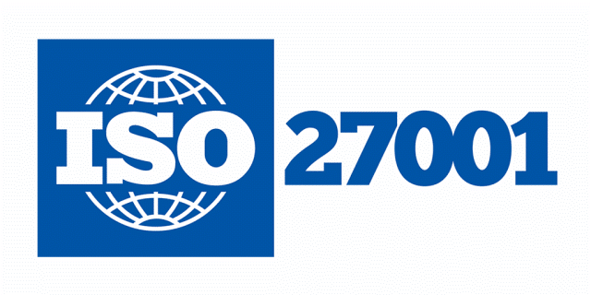
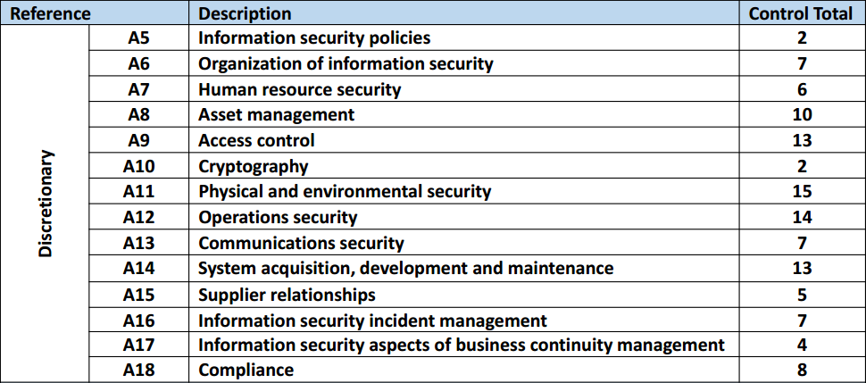
ISO27001:2013 Controls Appendix; Part 6
ISO27001:2013 DISCRETIONARY CONTROLS
TOTAL: 114
https://chapters.theiia.org/bermuda/Events/ChapterDocuments/Information%20Security%20Management%20System%20%28ISMS%29%20Overview.pdf

Slide 3
ISO27001:2013 Controls Appendix; Part 6
A.12 OPERATIONS SECURITY
A.12.1 OPERATIONAL PROCEDURES & RESPONSIBILITIES
A.12.1.1 | DOCUMENTED OPERATING PROCEDURES
A.12.1.2 | CHANGE MANAGEMENT
A.12.1.3 | CAPACITY MANAGEMENT
A.12.1.4 | SEPARATION OF DEVELOPMENT, TESTING, AND OPERATIONAL ENVIRONMENTS

Slide 4
ISO27001:2013 Controls Appendix; Part 6
A.12 OPERATIONS SECURITY
A.12.1.1 | DOCUMENTED OPERATING PROCEDURES | Control: Operating procedures shall be documented and made available to all users who need them.

Slide 5
ISO27001:2013 Controls Appendix; Part 6
A.12 OPERATIONS SECURITY
A.12.1.2 | CHANGE MANAGEMENT | Control: Changes to the organization, business processes, information processing facilities and systems that affect information security shall be controlled.

Slide 6
ISO27001:2013 Controls Appendix; Part 6
A.12 OPERATIONS SECURITY
A.12.1.3 | CAPACITY MANAGEMENT | Control: The use of resources shall be monitored, tuned and projections made of future capacity requirements to ensure the required system performance.

Slide 7
ISO27001:2013 Controls Appendix; Part 6
A.12 OPERATIONS SECURITY
A.12.1.4 | SEPARATION OF DEVELOPMENT, TESTING, AND OPERATIONAL ENVIRONMENTS | Control: Development, testing, and operational environments shall be separated to reduce the risks of unauthorized access or changes to the operational environment.

Slide 8
ISO27001:2013 Controls Appendix; Part 6
Lets continue to look at operations security in the next module…
END

